Slide 1
Basics of Machine Learning with Python
A 2 day hands on workshop by Evam Kaushik

Slide 2
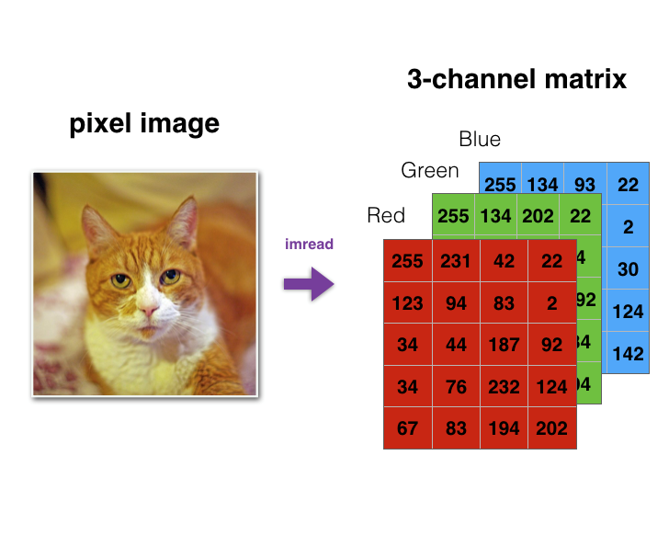
NumPy
NumPy is a python library that enables us to manipulate numeric data with precision and ease, especially matrices. It is the building block of most of python’s scientific stack. NumPy provides fast arrays, or matrices, math functions, linear algebra, randomization, and more.
This is very important as a lot of our data is modeled as arrays or matrices for example colored images are made up of 3 channel of matrices of Red, Green and Blue each.

Slide 3
Overview of commonly used functions
First up you have to import NumPy into your code with the command ‘import numpy as np’. The abbreviation np is used so you don’t have to write a lengthy command everytime.
Once you’ve done that, Let’s start by making a list and turning it into a N-Dimensional NumPy array.
Now we will learn to create 2 and 2+ dimensional arrays (you can virtually create a matrix of any dimension)

Slide 4
Why we use NumPy over standard python library for computation
Particularly this is because NumPy computation is significantly efficient in terms of resources like memory and CPU usage.
There are a vast number of operations available for NumPy that can help when dealing with data.
Many other libraries have an extended support for NumPy operations and NumPy data types.

